Slide 1
VCTF – Bob Hogg Statistical Analysis Toolkit for Questionnaires
Dr Bob Hogg
Sport Team
Faculty of Health Sciences and Wellbeing
(General “stats nerd”)

Slide 2
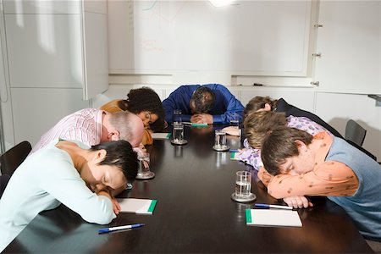
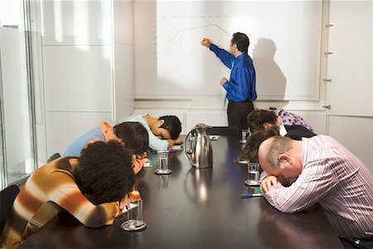
The Problem with this Subject ….

Slide 3
Motivation ……
Research Student - Central Development Programme
Referrals to help students with data analysis
Often AFTER data has been gathered
Sometimes mistakes
On occasion – data cannot answer research question
Often lack of robustness and validation
Often unaware of suitable visualisation or statistic test

Slide 4
(Initial) Plan ……
Repository of Online Learning Materials via Canvas Commons
Work with faculties to develop suitable questionnaire material
Review what might be needed
Develop online learning materials on advanced topics
Concentrate on implementation in SPSS
Develop and deliver staff training

Slide 5
(final) Plan ……
Repository of Online Learning Materials via Canvas Commons
Common questionnaire – new module feedback form
(based on Self-Determination Theory + Learning Climate Questionnaire)
Materials from level 4 to level 8
Introduction to site licence or open source software
SPSS
AMOS
RDSAnalysis
R
Statscloud

Slide 6
(current) Plan? ……
Repository of Online Learning Materials via Canvas Commons
Delivered sessions for nursing students
Delivering Masterclasses through European Social Fund
One day masterclasses for business
Staff CPD sessions in 2022-23

Slide 7
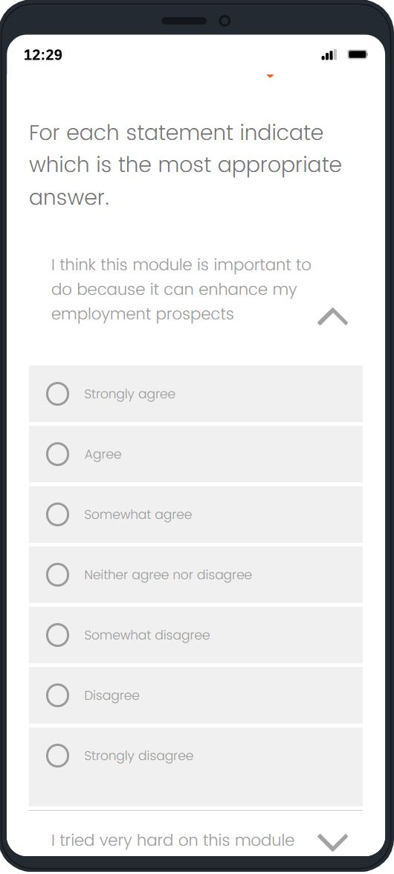
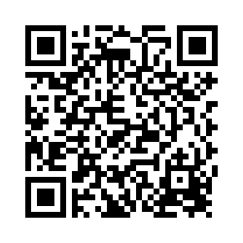
New Module Feedback Form
Qualtrics https://sunduni.eu.qualtrics.com/jfe/form/SV_0Uod9ztoBe32gKy
Interest/Enjoyment
Perceived Competence
Effort/Importance
Value/Usefulness
Learning Climate
Try Me!

Slide 8
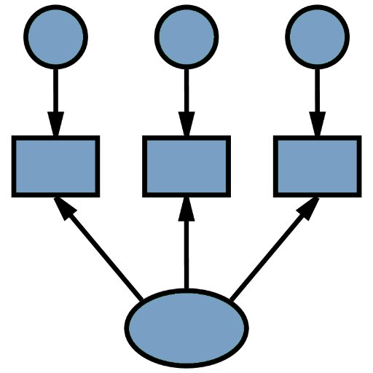
Software
Software instruction
IBM SPSS (site licence) - Windows, Mac
IBM AMOS (site licence) - Windows
RDS Analysis (open source) - Windows, Mac
iNZight (open source) - Windows, Mac, online
StatsCloud (open source) - Online

Slide 9
Materials …… level 4-6
Research Methodology
Visualising Data
Summary Statistics
Survey Coding
Hypothesis Testing
(Univariate) Test Assumptions
Comparing Groups (between and within)
Associations
Simple Regression

Slide 10
Materials …… level 7-8
Multiple Regression (SPSS v AMOS)
Logistic Regression
Principle Components Analysis (PCA)
Exploratory Factor Analysis
Confirmatory Factor Analysis
Path Analysis
Structural Equation Modelling (SEM)
Classification and Regression Trees
Social Network Analysis
(Multivariate) Test Assumptions
MANOVA

Slide 11
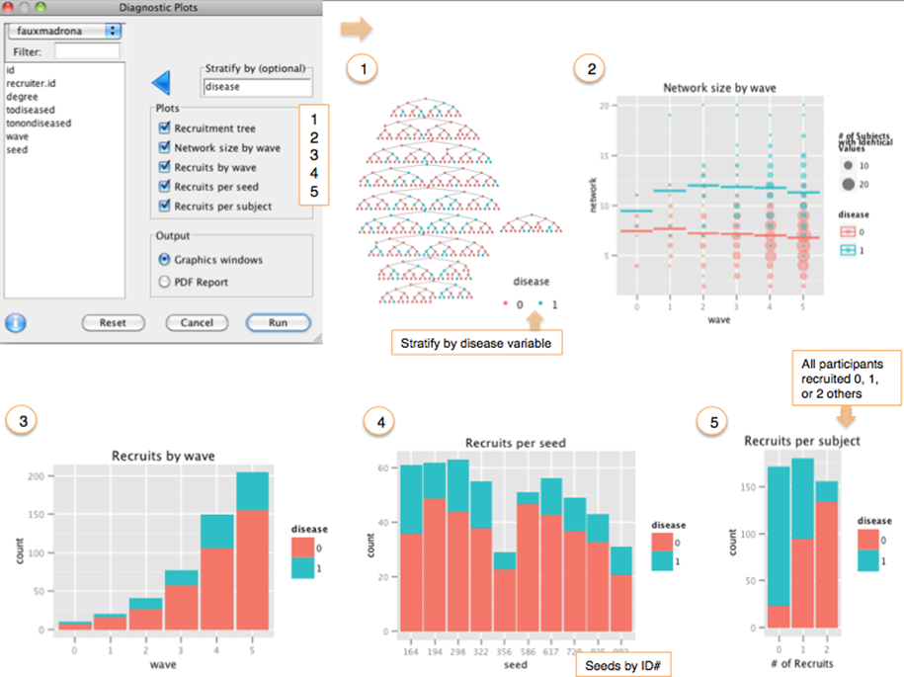
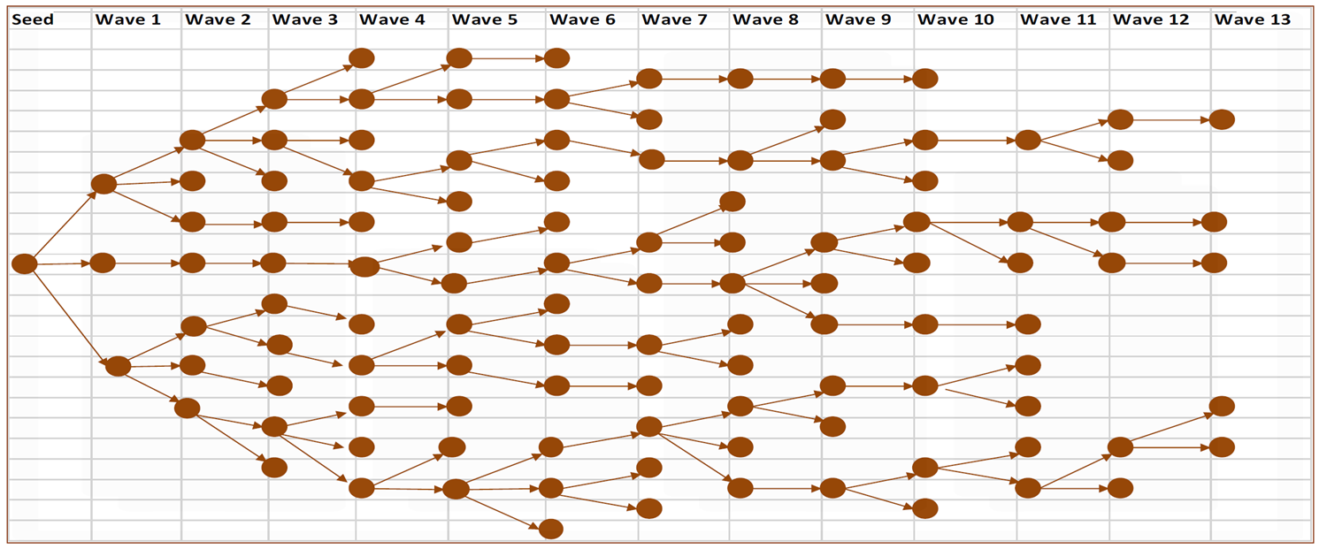
Interesting Techniques – RDS Sampling
RDS Analysis (Mark Handcock, Krista Gile, Ian Fellows)

Slide 12
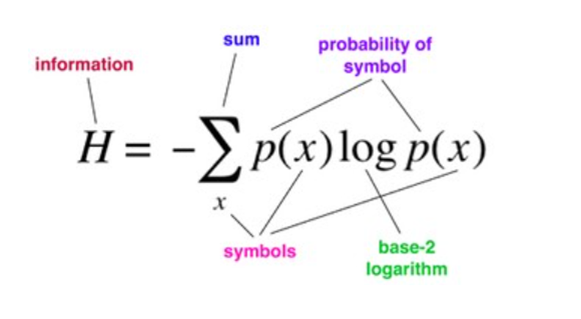
Interesting Techniques – Classification and Regression Trees
Classification and Regression Trees
Information Entropy Calculations!
Bagging
Random Forests

Slide 13
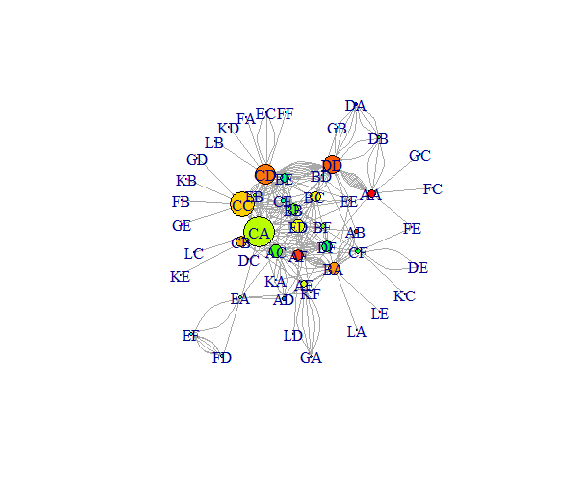
Interesting Techniques – Social Network Analysis
Igraph (Csardi and Nepusz 2006)

Slide 14
Interesting Techniques – Advanced Correlation Analysis
SPSS and Manual Calculations
 | Natural Dichotomy | Multichotomy | Ordinal | Interval
Natural Dichotomy | Phi (φ)
Multichotomy | Special Equ. (Wherry 1984) | Cramer’s V
Ordinal | Special Equ. (Wherry 1984) | Special Equ. (Wherry 1984) | Kendall (τ-b) Kendall (τ-c) (excludes ties) Spearman (ρ)
Interval | Point-biserial (natural) or Biserial (forced) | Eta (ε, η) | Special Equ. (Wherry 1984) | Pearson r

Slide 15
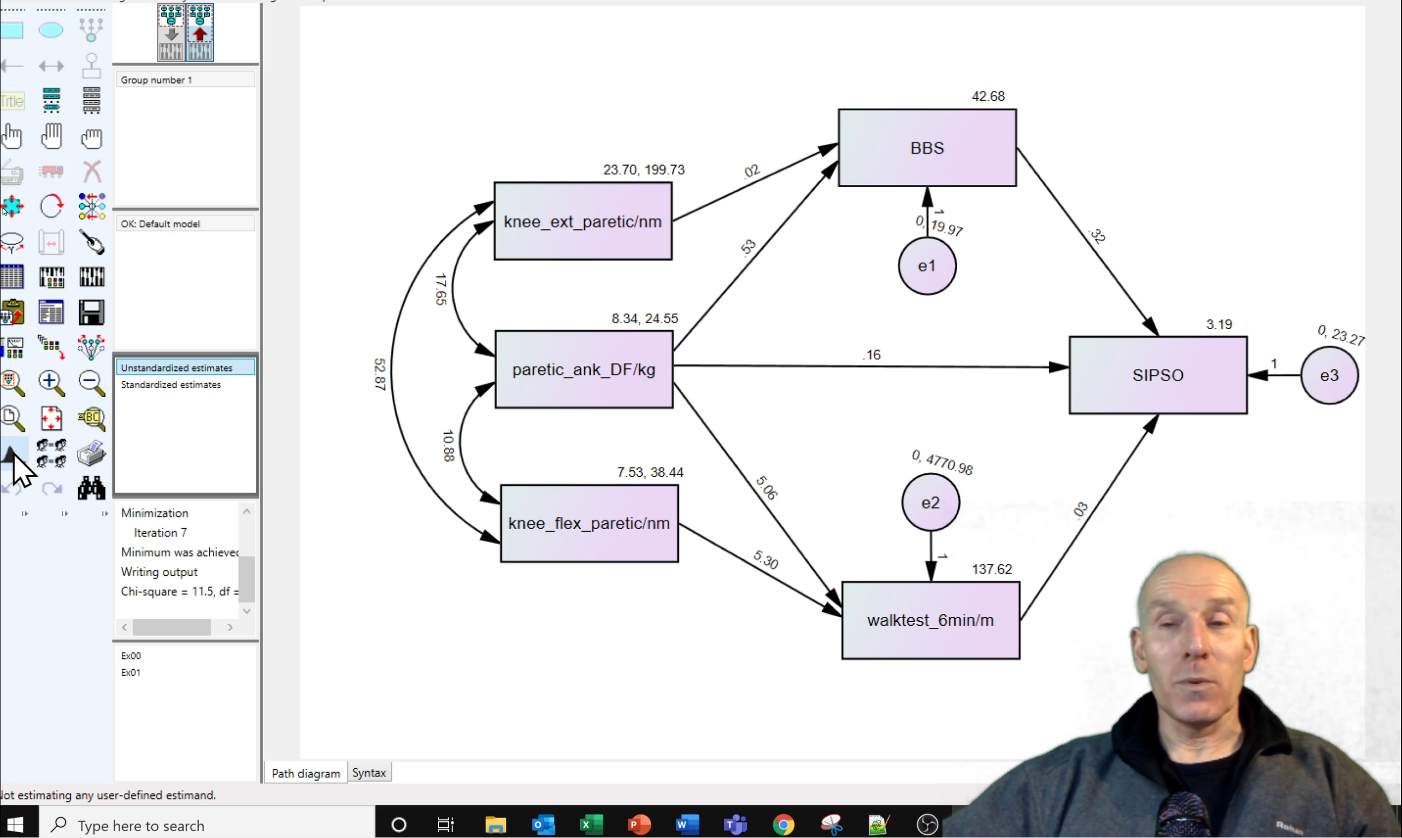
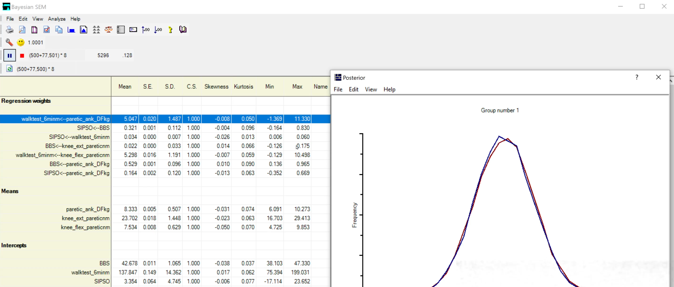
Interesting Techniques – Path Analysis/SEM
AMOS
Path Analysis
Structural Equation Modelling (SEM)
Bayesian SEM

Slide 16
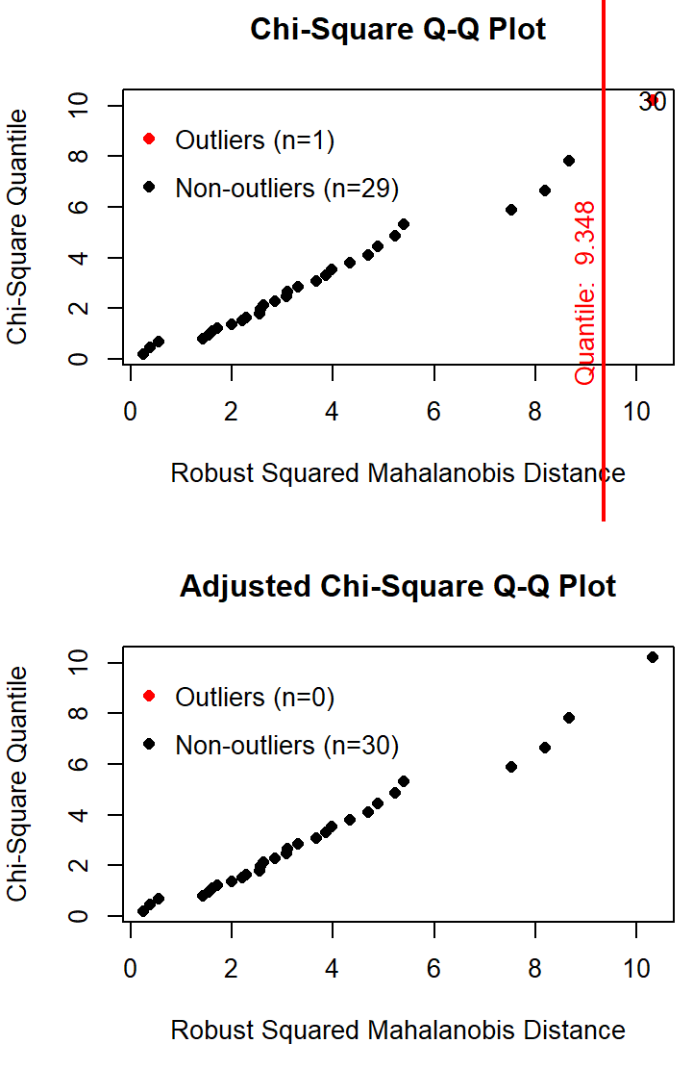
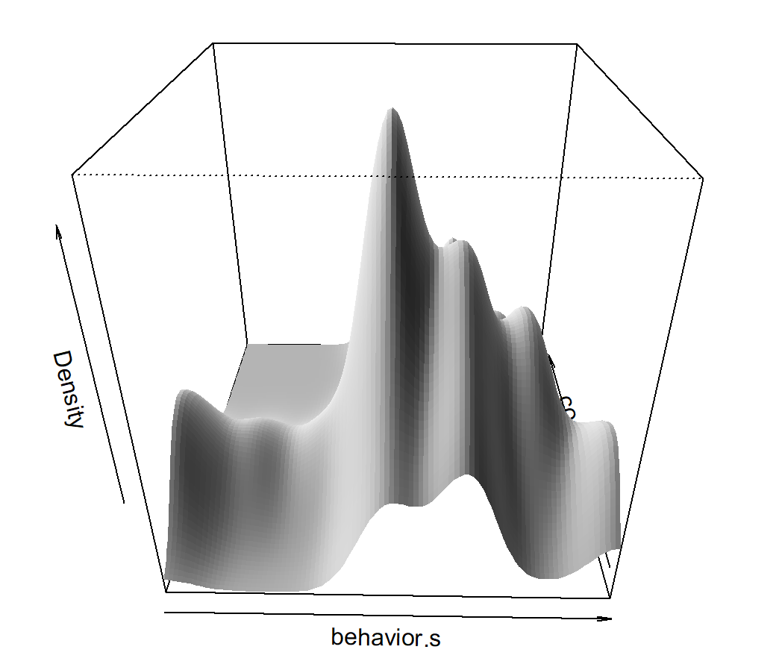
Interesting Techniques – Multivariate Normality
Mardia’s multivariate skewness and kurtosis
Henze-Zirkler’s test
Royston’s test
Doornik-Hansen’s test
Energy test

Slide 17
Search by …… Level

Slide 18
Search by …… FAQ

Slide 19
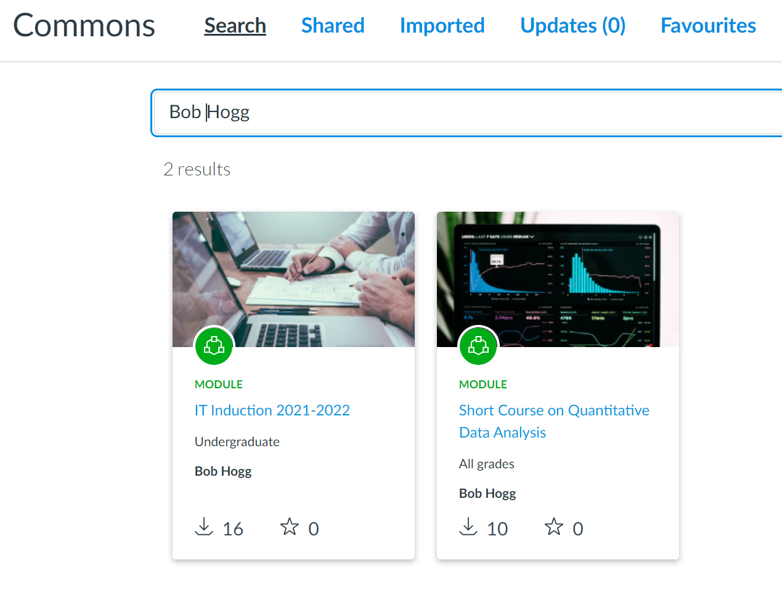
Where Can I Find It ? (eventually)

